Slide 1
Quantum-powered Genetic Variation Modeling

Slide 2

Thought Process
We wanted an application that would help in decision-making in the medical field. Thus, after vigorous research, we chose to employ randomness in exploring genetic variations
Genetics, particularly allele variation across populations, is highly unpredictable, making it an exciting field to merge with quantum mechanics, where probabilities drive outcomes.
Application
Using the Quantum Random Number Generator (QRNG) to model genetic variation across populations with mixed ethnicities. The model can give insight to medical professionals or data scientists on the prevalent genetic makeup of the studied population.

Slide 3

Why?
Differences in genetic makeup profoundly impact a population’s susceptibility to infectious diseases, illnesses and pandemics, such as Cancer, as well as their response to treatments and recovery outcomes.
This model generates a statistically accurate dataset on the genetic variation across mixed population.
This is essential for developing targeted interventions and treatments that are tailored to the unique genetic profiles within a population, ultimately enhancing public health strategies and treatment efficacy.

Slide 4
Biological Insight
SNP (Single Nucleotide Polymorphism) is the most common type of genetic variation among people. It represents a variation at a single position in a DNA sequence. For example, one person might have an "A" at a specific spot in their DNA, while another has a "G."
For SNPs, alleles are simply different possible values at that SNP location. In the example above, G and A are two possible alleles at that SNP position.
Allele Frequency:
Different ethnicities can have varying probabilities of carrying one allele over another at a specific SNP location due to genetic inheritance. For example for Africans the allele frequency of "A" can be 0.6 (60% chance of carrying allele “A”) but 0.3 for Europeans.
DNA Sequence
A T _ C
SNP location
Can be A or G for ex.

Slide 5
Algorithm
Setting Up Allele Frequencies and Population Mix Ratios
def get_population_parameters():
allele_types = input("Enter the types of alleles to randomize between (e.g., 'A G'): ").split()
populations = {}
while True:
pop_name = input("Enter an ethnicity name (or type 'done' to finish): ")
if pop_name.lower() == 'done': # Exit loop if 'done' is entered
break
allele_freq = float(input(f"Enter the probability of allele '{allele_types[0]}' for {pop_name} (0 to 1): "))
mix_ratio = float(input(f"Enter the population mix ratio for {pop_name} (0 to 1): "))
populations[pop_name] = {'allele_freq': allele_freq, 'mix_ratio': mix_ratio}
return allele_types, populations
get_population_parameters()
This function prompts the user for input on allele types and population parameters, then stores this data in a dictionary.
Input:
User is asked to input the types of alleles (e.g., 'A G').
User is prompted to enter info for the multiple ethnicities within the population (ethnic name, allele frequency, and population mix ratio) until they type 'done'.
Output:
Returns a list of allele types and a dictionary with population data (allele frequency and mix ratio for each ethnic group within the population).

Slide 6
Algorithm
2. Setting Up a Quantum Circuit
qc = QuantumCircuit(1, 1)
qc.h(0)
qc.measure(0, 0)
simulator = AerSimulator()
compiled_circuit = transpile(qc, simulator)
A quantum circuit is created with 1 qubit and 1 classical bit.
qc.h(0): A Hadamard gate is applied to the qubit, putting it in a superposition between 0 and 1.
qc.measure(0, 0): This measures the qubit's state (0 or 1) and stores the result in the classical bit. This measurement will introduce randomness.
An AerSimulator is initialized to simulate quantum behavior.
transpile(qc, simulator): optimizes the circuit to run on the simulator.

Slide 7
Algorithm
3. Generating an Allele Using Quantum Randomness:
The function generate_allele_quantum is designed to generate one allele from the two the user has chosen based on the quantum randomness and the specific allele frequency for the selected population.
Step 1: Generate a random bit 0 or 1 (each number corresponds to an allele eg. “A” or “G”)
def generate_allele_quantum(allele_probability, allele_types):
job = simulator.run(compiled_circuit, shots=1)
result = job.result()
counts = result.get_counts()
random_bit = list(counts.keys())[0]

Slide 8
Algorithm
Step 2 : generate a probability
Additional randomness is executed to estimate a population allele frequency probability_count
3. Generating an Allele Using Quantum Randomness:
job_probability = simulator.run(compiled_circuit, shots=10)
result_probability = job_probability.result()
counts_probability = result_probability.get_counts()
probability_count = counts_probability.get('0', 0) / 10
By running the circuit 10 times and calculating the fraction of 0’s, it gives us an approximate probability value based on randomness.

Slide 9
Algorithm
3. Generating an Allele Using Quantum Randomness:
Step 3: Make a Decision
The function decides on the allele based on random_bit and probability_count
if random_bit == '0':
return allele_types[0] if probability_count < allele_probability else allele_types[1]
else:
return allele_types[1] if probability_count < allele_probability else allele_types[0]
If random_bit is 0, it checks if probability_count is below the population’s allele_probability. If so, it returns the assigned allele of 0; otherwise, it returns the assigned allele of 1.
If random_bit is 1, the logic is inverted, returning the assigned allele of 1 if probability_count is below the threshold and the assigned allele to 1 otherwise.

Slide 10
Algorithm
4. Simulating the Mixed Population Data
This section generates allele pairs for a sample population, taking into account population mix and allele frequencies.
def generate_population_data(population_size, allele_types, populations):
population_mix = {k: v['mix_ratio'] for k, v in populations.items()}
mixed_population_data = []
for _ in range(population_size):
population = np.random.choice(list(population_mix.keys()),
p=list(population_mix.values()))
allele_prob = populations[population]['allele_freq']
allele_1 = generate_allele_quantum(allele_prob, allele_types)
allele_2 = generate_allele_quantum(allele_prob, allele_types)
mixed_population_data.append((population, allele_1, allele_2))
return mixed_population_data

Slide 11
Algorithm
The function begins with setting the number of individuals in the simulated population.
Each individual is assigned to a population based on population_mix probabilities.
The allele frequency for that population is used to generate two alleles (allele_1 and allele_2) using generate_allele_quantum.
The population and alleles are stored in mixed_population_data.
The function returns mixed_population_data, a list containing our simulated individuals.
Finally, the data is plotted on a histogram.

Slide 12
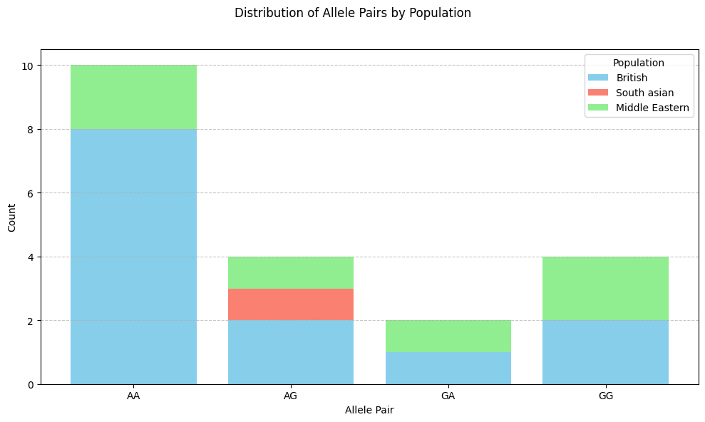
Sample Output
London, UK (a mix of british, south asians, and middle easterns)
Sample output of 10 people for inspection
Data
(Population, Allele 1, Allele 2):
[('British' 'A' 'A')
('South asian' 'A' 'G')
('British' 'A' 'G')
('British' 'G' 'G')
('Middle Eastern' 'A' 'G')
('Middle Eastern' 'A' 'A')
('British' 'A' 'A')
('British' 'A' 'A')
('British' 'A' 'A')
('Middle Eastern' 'G' 'G')

Slide 13
Why quantum NOT classical
Individual genotypes vary unpredictably especially across mixed populations due to biological processes like mutation, genetic drift, and recombination that are inherently random and do not follow predictable patterns.
QRNG
Classical RNG
Derives randomness from quantum phenomena which is fundamentally unpredictable, reflecting the diverse variations in gene sequences
As your simulation scales (e.g., increasing population size, running multiple simulations) QRNGs maintain a high degree of true randomness without accumulating the biases that may arise from repeated classical RNG use.
-Relies on algorithms, which means they are ultimately deterministic
-Over many iterations, patterns or correlations may emerge
In summary, QRNGs improve the authenticity and reliability of your genetic variation simulation by providing truly unpredictable randomness, which classical RNGs struggle to match. This results in a more accurate, bias-free model that better reflects real-world genetic diversity, especially valuable for applications in medical genetics and population studies.

Slide 14
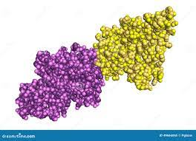
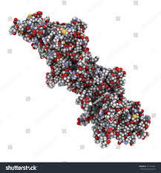
Case Study
Example
Breast Cancer
Breast cancer is one of the most common cancers worldwide, and certain genetic mutations, particularly in the BRCA1 and BRCA2 genes,
significantly increase the risk of breast and cancers.
People who carry these mutations have a much higher lifetime risk of developing these cancers compared to those without the mutations.

Slide 15
Case Study
Example Scenario
Suppose your application is run in a region where data shows a higher frequency of BRCA1 mutations. Health agencies could use this information to:
Offer subsidized genetic testing in that area, making it affordable for individuals who might otherwise not access it.
Develop public awareness campaigns emphasizing the importance of genetic screening for BRCA mutations and outlining steps for individuals who test positive.
Collaborate with hospitals and clinics to provide specialized support services for individuals with BRCA mutations, including regular screenings, genetic counseling, and support groups.

Slide 16
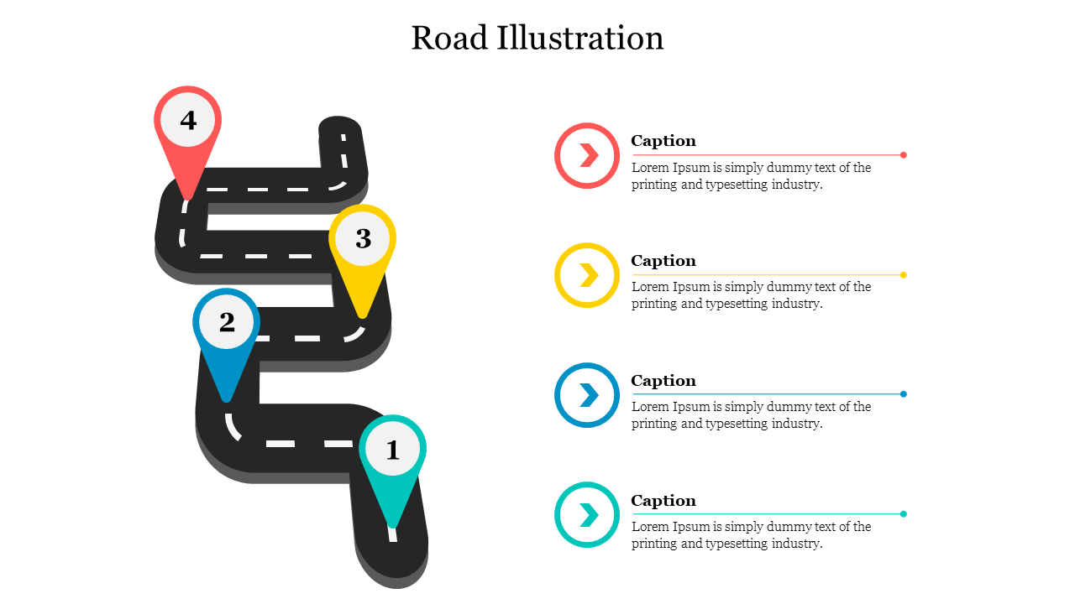
Challenges in Our Quantum Journey
Debugging code
Coding in a different way: using different libraries than the classical ones, and handling new types of Errors
Bridging the gap between our engineering knowledge and biological concepts
Understanding and implementing Genetic concepts
Searching for an application:
Utilizing these learnt techniques to apply to a useful application.
Grasping the idea of quantum computing:
from knowing nothing to building something in 5 days

Slide 17
Thank You
Any questions?
Zeina Abdelaal
Farah Abdelaal
Farah Haitham
Ahmed Shawki

